Slide 1
Sampled-Data and Digital Control Systems
Course overview
Background knowledge
Analog-to-Digital converters
  Digital signals
Approximation of differential equations using difference equations
Digital-to-Analog converters
  Delay

Slide 2
I assume you have a background in introductory feedback control (at the level of ECEN 4138/5138).
You should know:
Laplace transforms
Block diagram analysis
P, I, D control
Lead and lag compensation
Stability
Root locus
Frequency response: Bode and Nyquist plots
Introductory state-space representations
  Relationship to transfer functions
  State-feedback controllers

Slide 3
In practice, controllers are often implemented digitally:
“Good” performance usually means . . .
Output follows or tracks reference “well” despite . . .
  Disturbances and sensor noise
  Modeling errors
  Parameter variations
Feedback systems are more robust than open-loop systems.

Slide 4
Analog-to-Digital (A/D) Converters
Convert a continuous physical variable (usually a voltage) to a stream of numbers

Slide 5
A discrete signal can only change at discrete times.
A sampled-data system is a system having both discrete and continuous signals.
A/D converters not only provide a discrete signal, but also a quantized signal --- that is, the signal must be stored in a finite number of bits.
  Quantization is a nonlinear function.
A signal that is both discrete and quantized is a digital signal.
  Digital computers process digital signals.

Slide 6
Digital controller analysis and design: take into account effects of sampling period T and the quantization size q.
If both T and q are extremely small . . .
  the digital signals may be considered nearly continuous,
  and continuous methods of analysis and design can be used, and then converted to the digital domain.
In this course, we will try to gain an understanding of the effects of
  Sample rates (fast and slow)
  Quantization (large and small word sizes)
Why not just always make sure the sampling rate is fast and the quantization size is small --- and then just design D(s) and approximate it with D(z) ?

Slide 7

In this course, we will largely treat the problem of varying T and q separately.
~13 weeks
  Consider only the effect of T, assuming q = 0 .
  Assume linearity and time-invariance (what is LTI?)
~1 week (depending on student interest and avail time)
  Effects of
    Some discussion on the effects of quantization will be made in conjunction with earlier lectures

Slide 8
In more detail . . .
Chapters 3 & 4
~13 weeks, q = 0
  Discrete systems (linear, constant)
    Z-transform of discrete signals
    “pulse” transfer functions
  Sampled-data systems
    Discrete transfer functions of continuous systems that are sampled
      System representations
        Transform methods
        State-space methods
  Dynamic response of discrete systems

Slide 9
In more detail (continued) . . .
Chapter 5
  Inter-sample ripple
  Fourier analysis
  Aliasing, sampling theorem
  Digital filters
  Design of feedback controllers
    Transform methods
      Root locus
      Frequency response
    State-space methods
Chapter 6
Chapter 7
Chapter 8

Slide 10
In more detail (continued) . . .
Depending on student interest and available time:
Chapter 10
~1 week
  Effects of
Will use MATLAB/Simulink in homeworks and labs/projects

Slide 11
Course-Level Learning Goals
Analyze sampled-data systems to determine stability and predict responses
Design digital controllers and analyze their performance using both frequency-domain (root locus, Bode, Nyquist) and time-domain (state-space methods)
Design digital controllers to meet certain (speed and precision) performance specifications

Slide 12
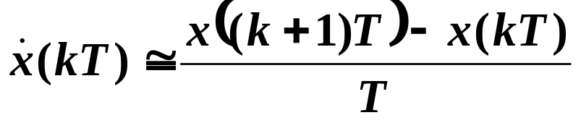
Digitization
How can we approximate a differential equation using a difference equation?
Euler’s Forward Rectangular Rule (or Euler’s Method):
You will explore Euler’s Backward Rectangular Method in HW 1 . . .

Slide 13
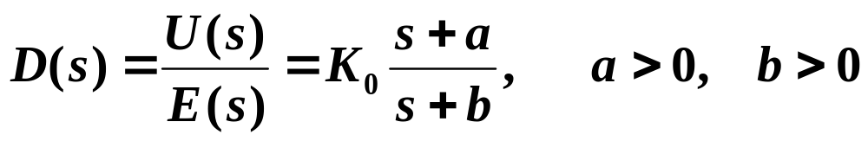
Example (3.1 of text)
Suppose
  General form of a lead or lag compensator
How can we implement this compensator using a difference equation?
  First, what is the differential equation that D(s) represents?

Slide 14

Example (continued) . . .
Apply Euler’s Method
Rework to write u(k+1) (the new “control”) as a function of the past control u(k) and the “current” and past “errors” e(k+1) and e(k).

Slide 15

Comments on Example
Best to rearrange calculations so that u(k+1) is output to plant as quickly as possible after “current” y and r are “read”.
  See example in Table 3.1 of text.
Implementing D(s) in this way will work well (meaning digital implementation leads to essentially the same performance as D(s))
  if the sample rate is BW of the system (where the bandwidth is of the closed-loop continuous system with D(s) . . .)

Slide 16
As the sample rate decreases below 30 x BW, the closed-loop control performance degrades
  More overshoot
  Appears to be less damped
  Longer settling times
In this class, we will spend some time discussing “good” methods of converting D(s) for discrete-time implementation if a continuous D(s) design is already available.
We will also discuss methods of directly designing a discrete controller.

Slide 17
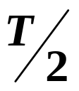
Digital-to-Analog (D/A) Converters
Single most important impact of implementing a control system digitally is the delay associated with the D/A.
Each value of u(kT) is typically held constant until the next value is available from the computer (called a Zero-Order Hold or ZOH).
  The continuous value of u(t ) consists of steps --- that on average lag u(kT) by .

Slide 18
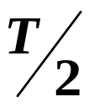
If we simply include a delay in a continuous-time analysis of a digital system ➔ good agreement results . . .
Performance of discrete-time implementation of D(s) with sample time T can be approximated by this system.
Delay in any feedback system degrades damping and ultimately stability of the system.

Slide 19
Could plot a locus of roots as a function of T to understand the behavior of the discretized implementation of D(s) on system performance . . .
Alternatively, the delay effect can be analyzed using frequency response techniques.

